Slide 1
Program Control: Selection
Algorithm and programming
Shania Priccilia, S.Kom., M.Kom.

Slide 2
Learning Objectives
At the end of this session, student will be able to:
Demonstrate usage of selection control in C programming language (LO2 & LO3)

Slide 3
Subtopics
Selection Definition
If
If-Else
Nested If -Else
Program Examples Using If
Switch-Case
Ternary Operator
Error Type
Exercise

Slide 4
SELECTION DEFINITION
In algorithm implementation, an instruction or a block of instructions may be executed based on a predetermined condition.
Syntax:
If
if-else
switch-case
These control structures allow conditional execution of code depending on whether specific conditions are true or false.

Slide 5
Selection: IF
syntax
if (boolean expression) statement;
or
if (boolean expression) {
statement1;
statement2;
……
}
If boolean expression resulting True, then a statement or some statements will be executed.
Block of statements

Slide 6
Selection: IF
flowchart
Flow Chart of IF Statement
false
true
condition
statements

Slide 7
Selection: IF-ELSE
syntax
if (boolean expression) statement1;
else statement2;
or
if (boolean expression){
statement1;
statement2;
……
}
else {
statement3;
statement4;
…
}
If boolean expression resulting TRUE, then statement1 or block statement1 will be executed, if FALSE then statement2 or block statement2 be executed.
Block of statements 1
Block of statements 2

Slide 8
Selection: IF-ELSE
flowchart
Flow Chart of IF-ELSE Statement
false
true
condition
statements 2
statements 1

Slide 9
Selection: IF-ELSE
Multiple conditions
if (boolean expression){
statement1;
……
}
else if(boolean expression){
statement2;
…
}
else if(boolean expression){
statement3;
…
}
Block of statements 1
If-else if allows program to choose one block of code to execute among many possible alternatives.
Block of statements 2
Block of statements 3

Slide 10
Selection: nested if-else
syntax
if (boolean expression){
if (boolean expression){
if (boolean expression) statement3;
}
}
or
if (boolean expression) statement1;
else{
if (boolean expression) statement2;
else{
if (boolean expression) statement3;
}
}
A nested selection occurs when an if statement is inside another if or else block.

Slide 11
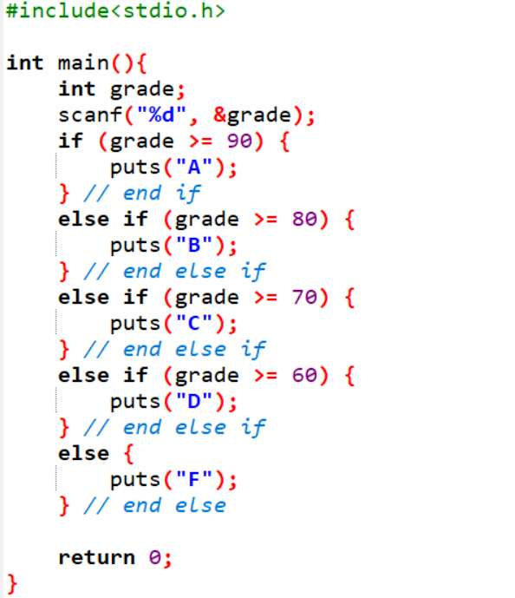
Program Examples Using If
Example:
Program example to determine a letter grade based on a numerical score
Algorithm:
Get the value of grade from the keyboard.
Check the value of grade using conditions:
If grade >= 90, then print "A".
Else if grade >= 80, then print "B".
Else if grade >= 70, then print "C".
Else if grade >= 60, then print "D".
Else, print "F".
Stop.

Slide 12
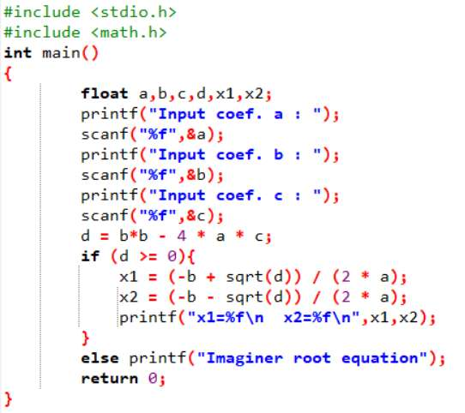
Program Examples Using If
Example:
Program example to find the roots of a quadratic equation
Algorithm:
Get the value of coefficients a, b, and c from keyboard
Calculate discriminant d = b*b – 4*a*c
if d >= 0 then calculate x1 and x2
if d < 0 then stated imaginer, stop.
Stop
Calculate x1 using :
Calculate x2 using :
-b +√ d
2*a
-b - √ d
2*a

Slide 13
Program Examples Using If
Sqrt()
Standard Library Function : sqrt()
The previous slide shows program example using sqrt() function
Syntax :
double sqrt (double x);
Header file: <math.h>
To find a square root for a value x, where x is non-negative
Example:
z = sqrt(45.35);
then value of z is 6.73

Slide 14
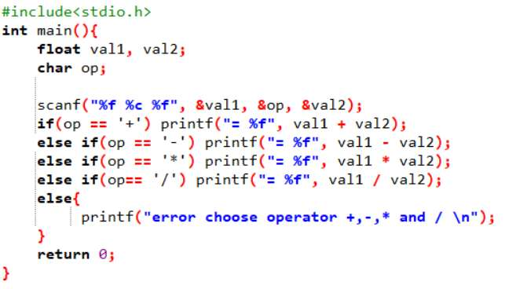
Program Examples Using If
Simple Calculator Program

Slide 15
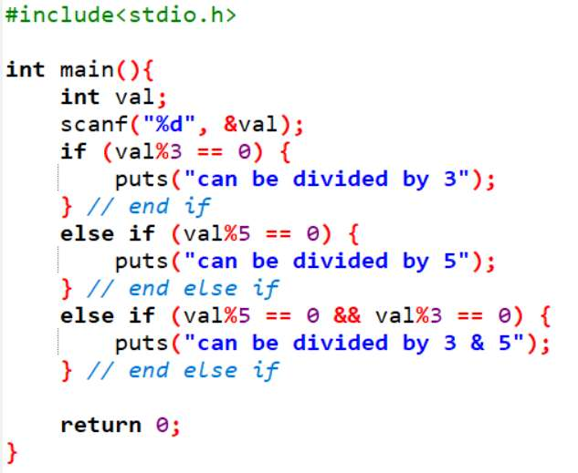
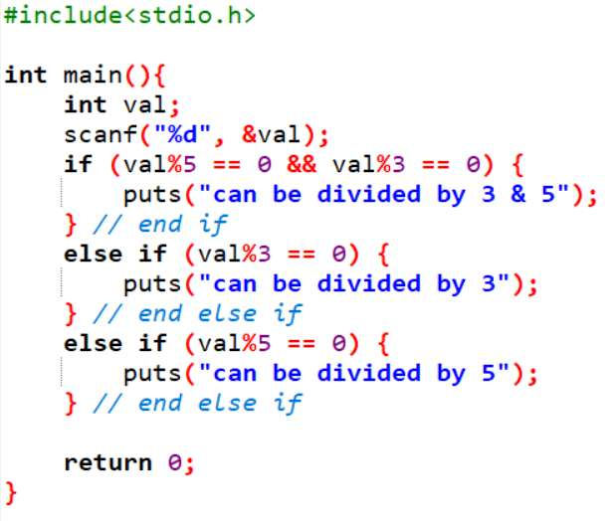
Program Examples Using If
Example wrong if (problem in logic order):
Example of clear if statement:
Program to check if a number is divisible by 3, 5, or both.

Slide 16
Selection: SWITCH-CASE
Definition
Switch statement evaluate an expression by looking up for each case constant value.
If an expression value matches with a case constant value then related statements is executed. If nothing match then default statement is executed.
Syntax:
switch(<variable>){
case <constant1>:
statements1;
break;
case <constant2>:
statements2;
break;
default:
statements
break;
}
Note:
The variable used in a switch statement must be of an integer type, such as int or char.
The default case is similar to the else clause in an if-else structure. It is executed when none of the case values match.

Slide 17
Selection: switch-case
flowchart
true
case a
case a action(s)
break
false
true
case b
case b action(s)
break
false
Flow Chart of Switch-Case Statement
.
.
.
true
case z
case z action(s)
break
false
default action(s)

Slide 18
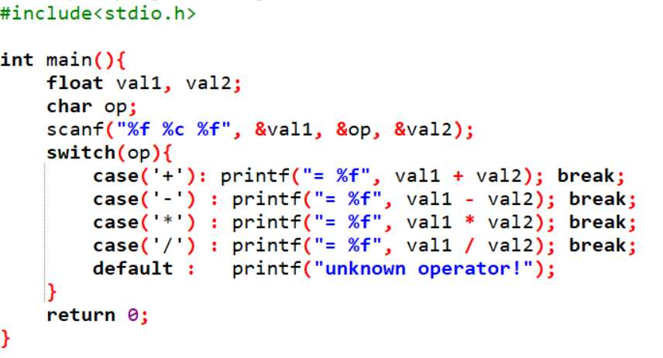
Selection: SWITCH-CASE
example
Simple calculator program
Note: case (’+’) can also written case ’+’

Slide 19
Ternary Operator
Definition
The ternary operator (?:) is similar to an IF statement, but it returns a value.
Syntax:
condition ? then-expression : else-expression
Using this operator, you can rewrite
if(a > b)
max_value = a;
else
max_value = b;
as
max_value = (a > b) ? a : b;

Slide 20
Go to label
Definition
C still provides the old-fashioned goto statement.
Syntax:
goto label;
……
label :
……
A label is written followed by a colon (:).
Avoid using goto to improve code readability and maintainability.

Slide 21
Error Type
definition
Compile-Time Error
Caused by syntax error
Link-Time Error
Success fully compiled, but cause link error
Caused by no object code at link time
Run-Time Error
Successfully compiled, but error at runtime.
Usually caused by numerical operation such as: overflow, floating point underflow, division by zero, etc.
Logical Error
Wrong result caused by incorrect logical flow/algorithm

Slide 22
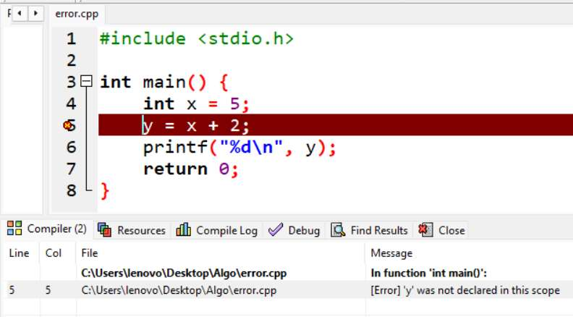
Error Type
Compile-Time error
Cause: syntax error, undeclared variable, etc.
Example of Compile-Time Error:
y is used without being declared. The compiler will catch this and refuse to compile.

Slide 23
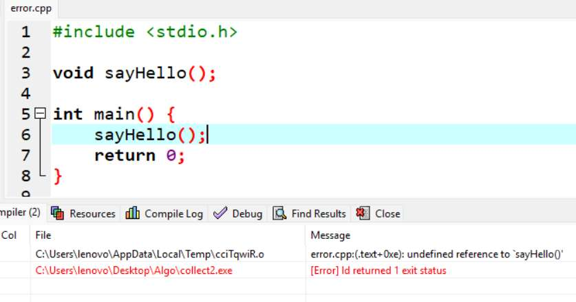
Error Type
LINK-Time error
Some C compiler merge the compile and link processes, causing in difficulty to distinguish between Compile-Time Error with Link-Time Error
Example of Link-Time Error
The compiler compiles the file, but during linking, it fails because sayHello is declared but not defined.

Slide 24
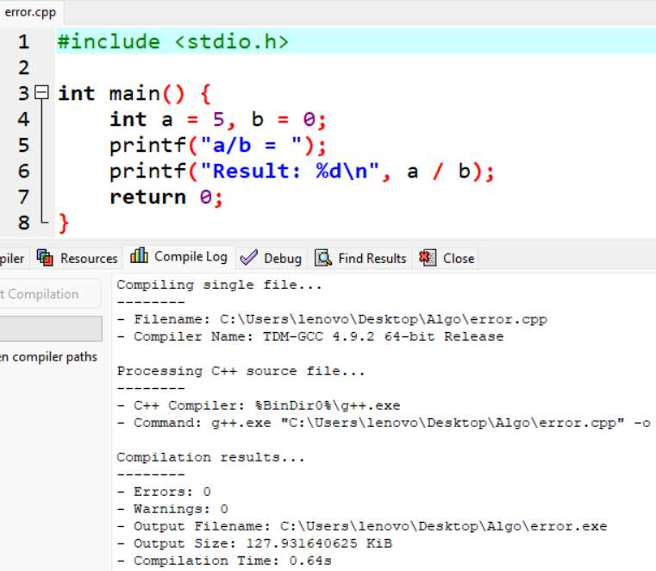
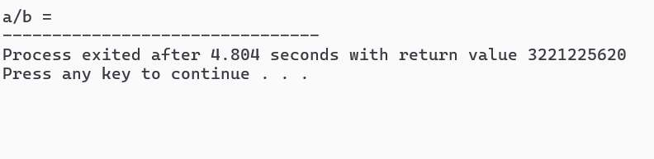
Error Type
run-Time error
Cause: Illegal operation during execution, such as division by zero.
Example of Run-Time Error
Division by zero causes the program to crash or behave unpredictably at runtime.

Slide 25
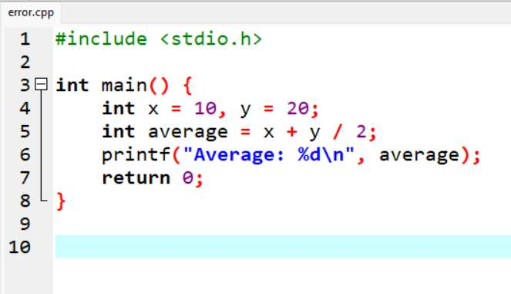
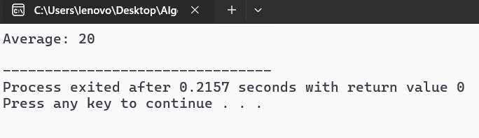
Error Type
logical error
Among those Error Types the most difficult to debug is Logical
Cause: Code runs without crashing but gives incorrect output.
Example of Logical Error
The program compiles and runs, but the logic is incorrect. It gives the wrong result without an actual crash.
Can you find the logic error?

Slide 26
exercise
Question 1:
Create a program to input value of student’s IPK (cumulative performance index) and state the grading:
3.5 - 4.0 → Cumlaude
3.0 - 3.4 → Outstanding
2.5 – 2.9 → Very Good
2.0 – 2.4 → Good
less than 2.0 →Poor
Use IF or IF-ELSE

Slide 27
exercise
Question 2:
Given the following code:
if(n > 0)
if(a > b)
z = a;
else
z = b;
Explain which “if” keyword does the else is pairing with ?
Fix the code to improve readability!

Slide 28
SUMMARY
In an algorithm implementation, an instruction or block of instructions may be executed (or not) with certain predetermined condition, that’s why we use selection
3 types of selection in C:
if
if-else
switch-case

Slide 29
REFRENCES
Paul Deitel & Harvey Deitel. (2021). C how to program. 09. Pearson Education. New York. ISBN: 9780137398393.
IF-ELSE: https://www.programiz.com/c-programming/c-if-else-statement
Getting Controls: http://aelinik.free.fr/c/ch10.htm

